Slide 1
Lab 5: Algebraic Operations
Examples and Deliverables
MAE 405, 2025 Spring
TA: Xinlei Zhang

Slide 2
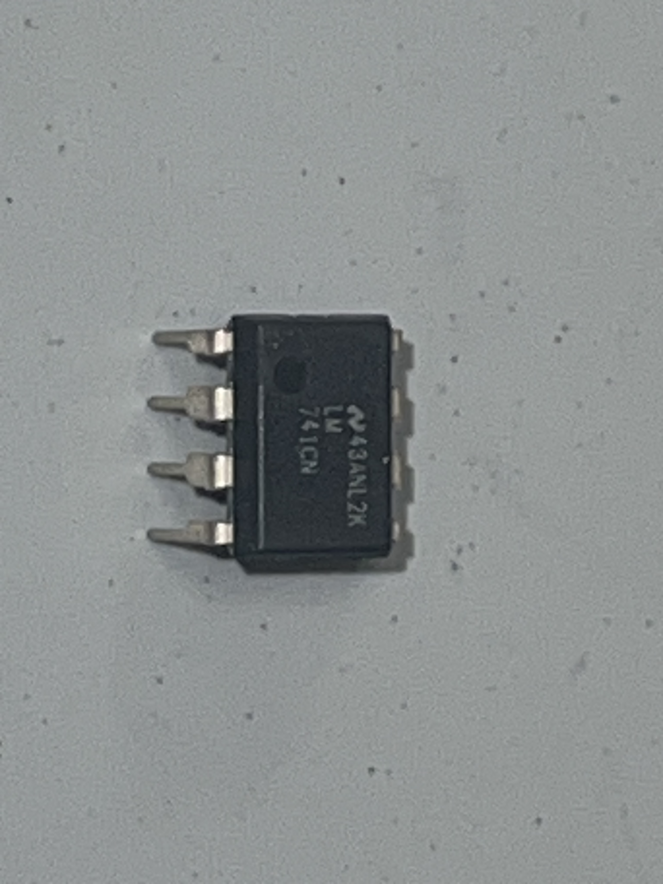
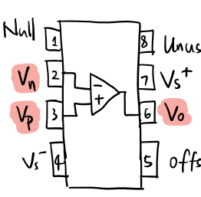
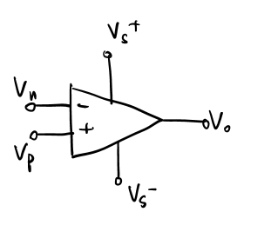
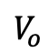
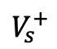
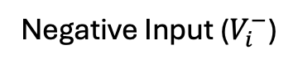
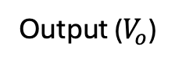
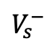
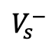
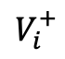
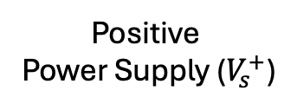
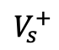
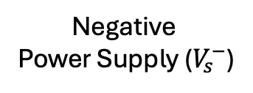
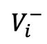
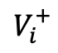
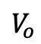
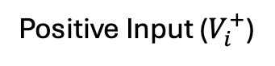
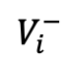
To be prepared with OPAMP
OPAMP (Operational Amplifier)
Orientation
Indicator
Model Number
Positive
Power Supply ($V_{s}^{+}$)
$$V_{s}^{+}$$
Negative Input ($V_{i}^{−}$)
$$V_{i}^{−}$$
$$V_{s}^{+}$$
Positive Input ($V_{i}^{+}$)
$$V_{i}^{−}$$
$$V_{i}^{+}$$
$$V_{o}$$
$$V_{i}^{+}$$
$$V_{o}$$
Negative
Power Supply ($V_{s}^{−}$)
Output ($V_{o}$)
$$V_{s}^{−}$$
$$V_{s}^{−}$$
OPAMP 741CN
OPAMP Diagram
Comments:
Put the Circle (orientation indicator) at the upper-left corner to align the OPAMP with the diagram
Identify the Model Number – 741CN

Slide 3
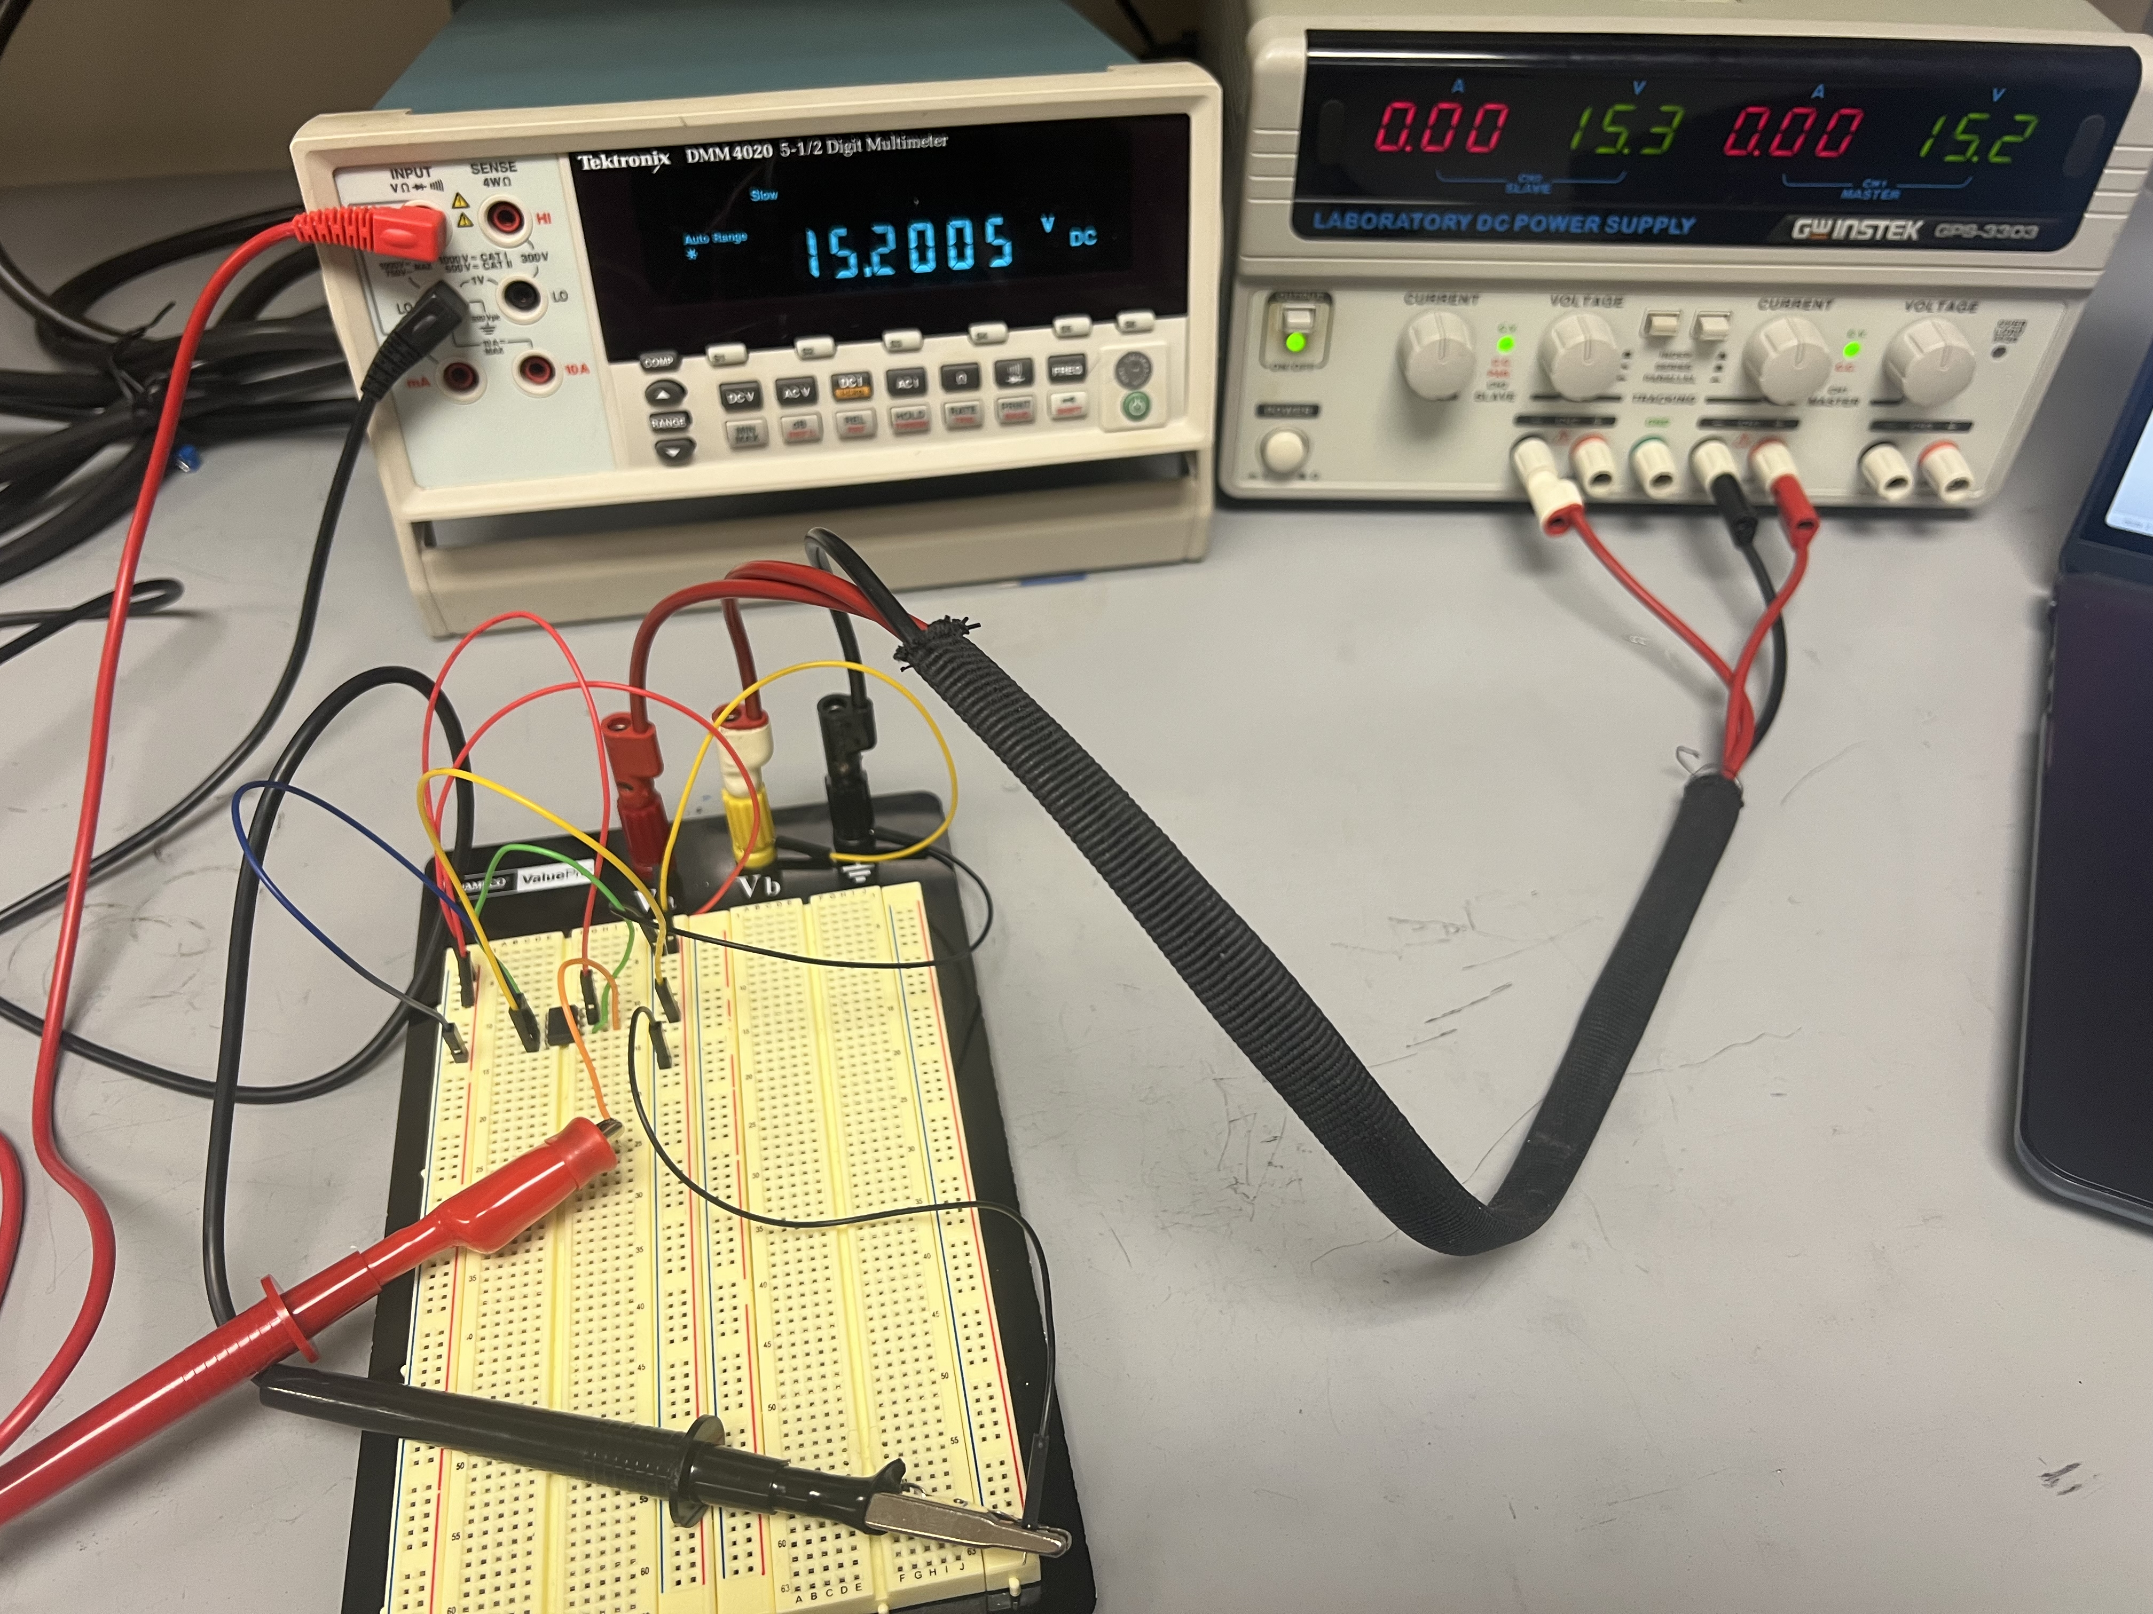
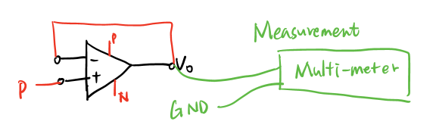
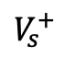
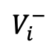
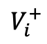
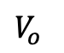
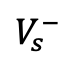
Example 1 (Deliverable 1 – Task A in Experiment 4)
Buffer Circuit – buffering +15V from the power source
$$V_{s}^{−}$$
$$V_{i}^{−}$$
$$V_{i}^{+}$$
$$V_{s}^{+}$$
Connection Diagram
$$V_{o}$$
GND
Expect Result: multimeter red input ($V_{o}=+15 V$) – multimeter black input ($0 V$) = $+15 V$

Slide 4
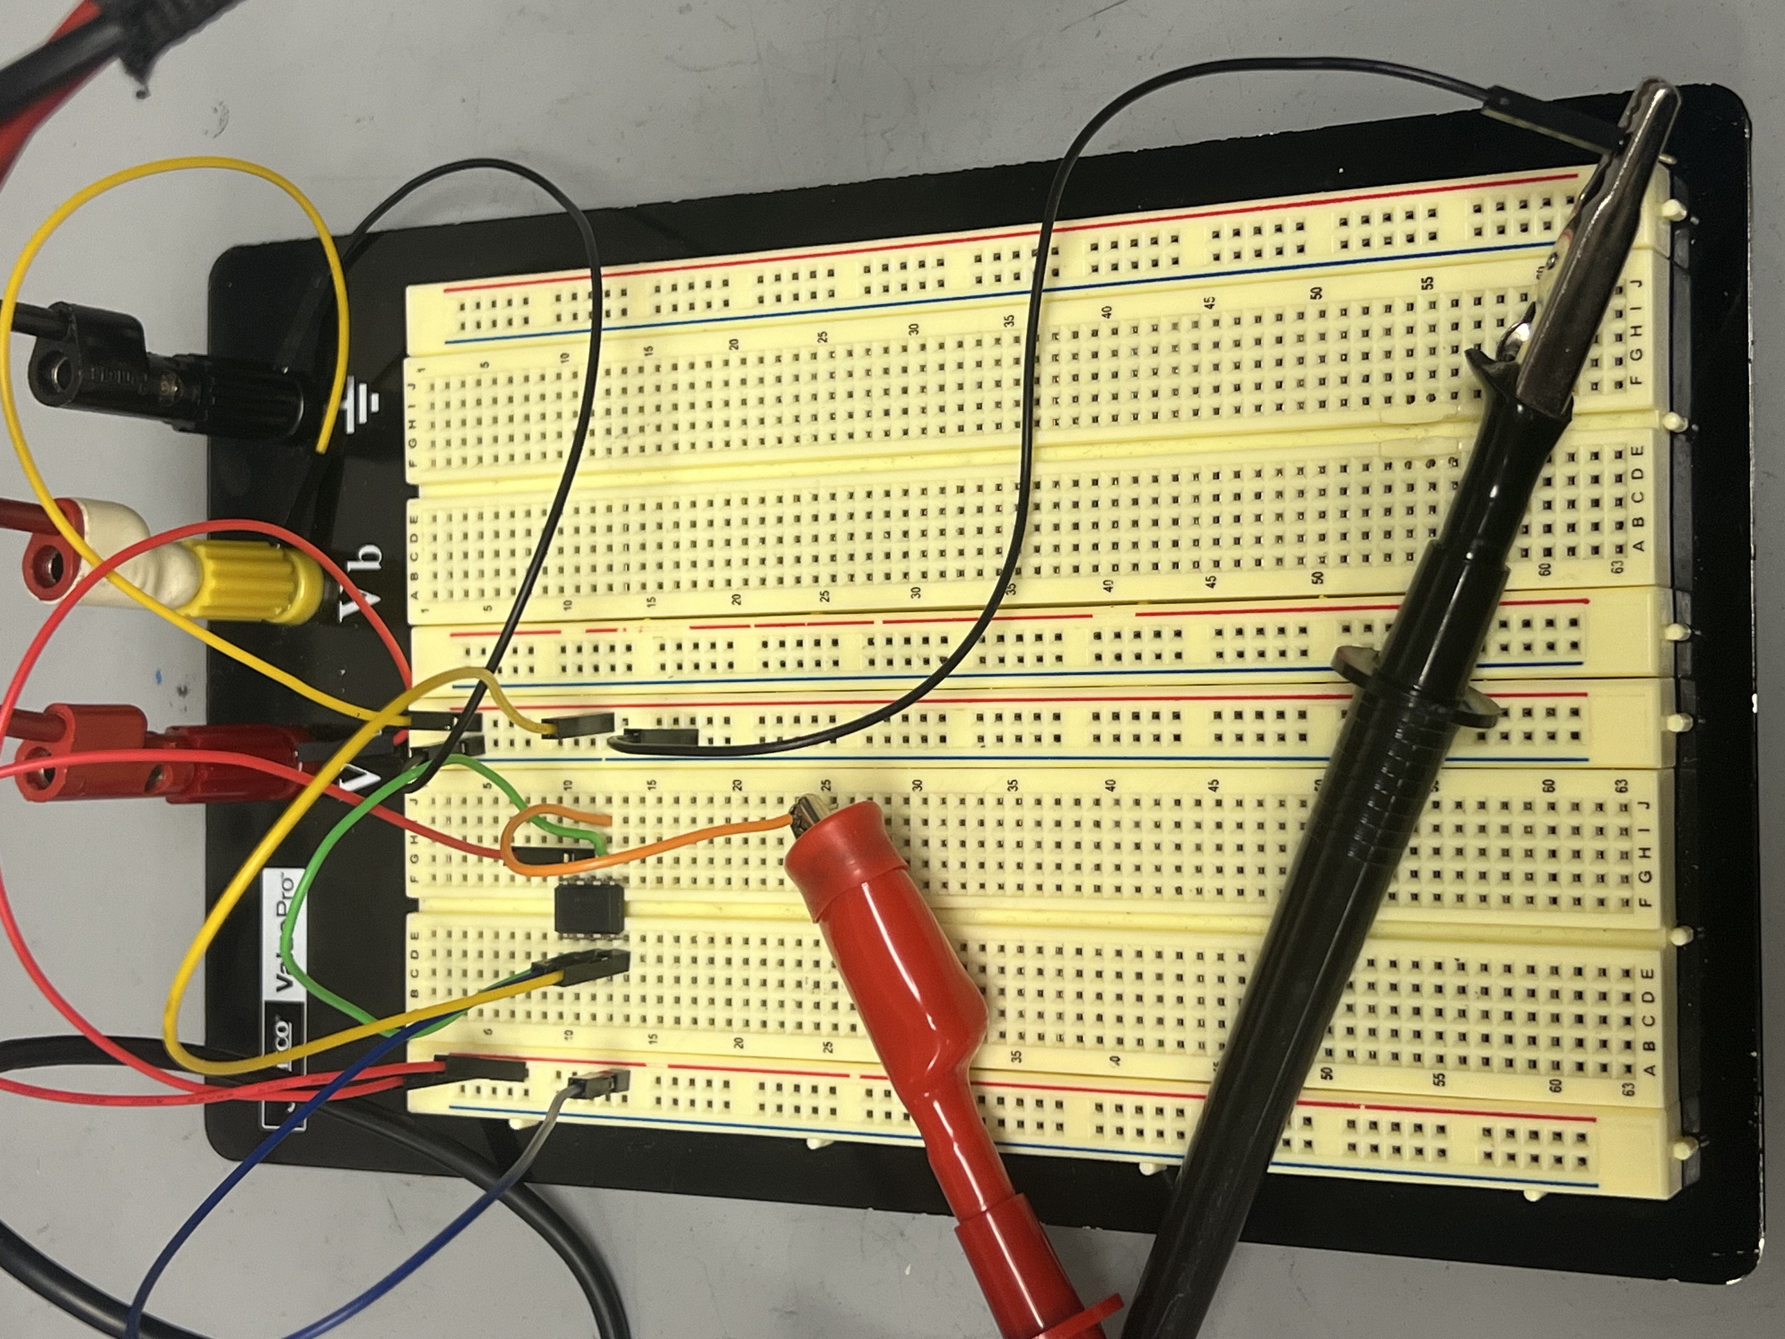
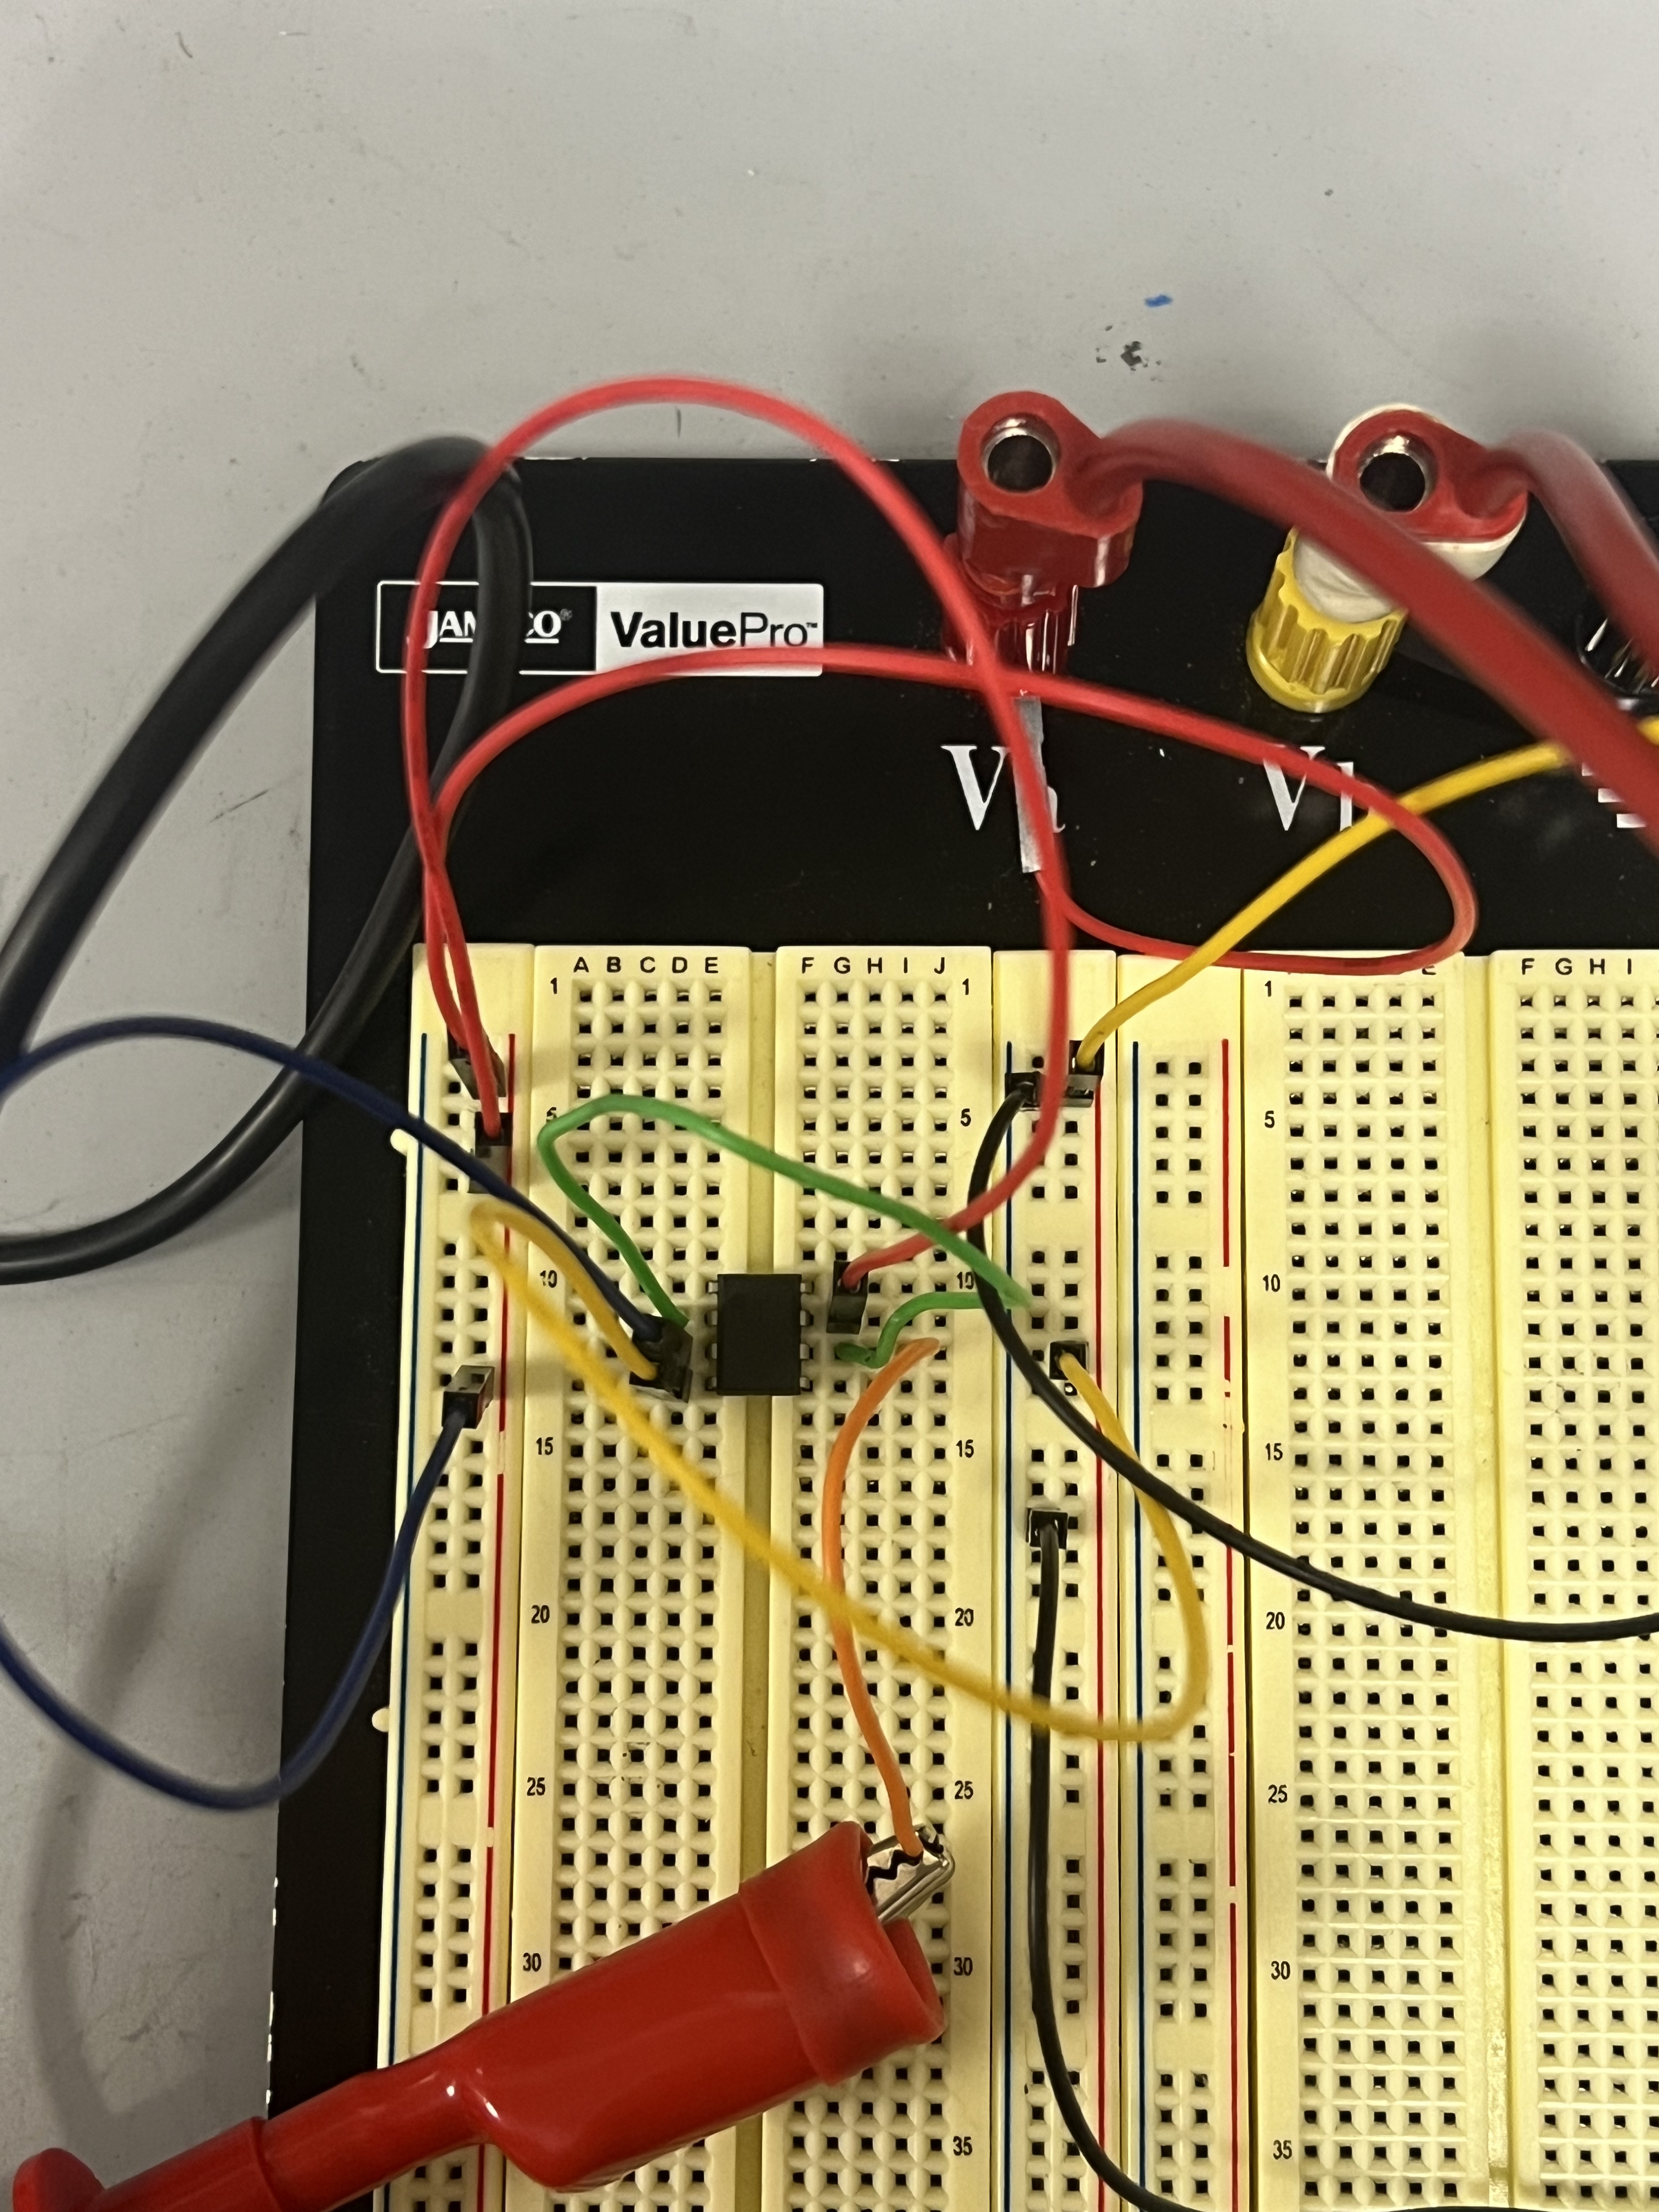
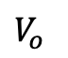
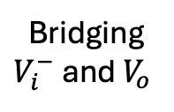
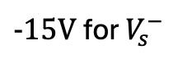
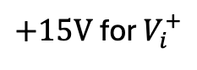
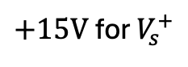
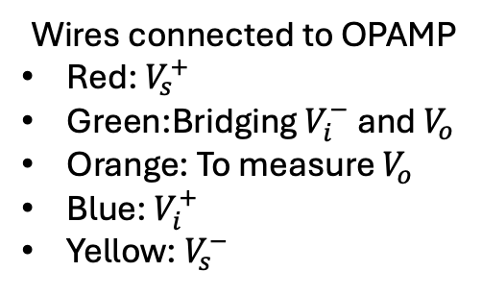
Example 1 – Cont’d
$+15V$for $V_{s}^{+}$
$+15V$for $V_{i}^{+}$
Wires connected to OPAMP
Red: $V_{s}^{+}$
Green:Bridging $V_{i}^{−}$ and $V_{o}$
Orange: To measure $V_{o}$
Blue: $V_{i}^{+}$
Yellow: $V_{s}^{−}$
$-15V$for $V_{s}^{−}$
Bridging
$V_{i}^{−}$ and $V_{o}$
$V_{o}$

Slide 5
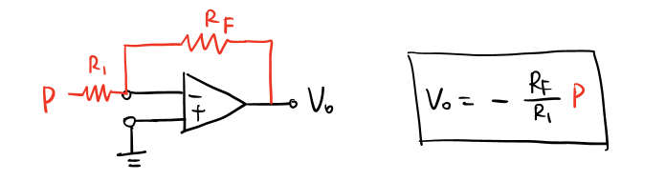
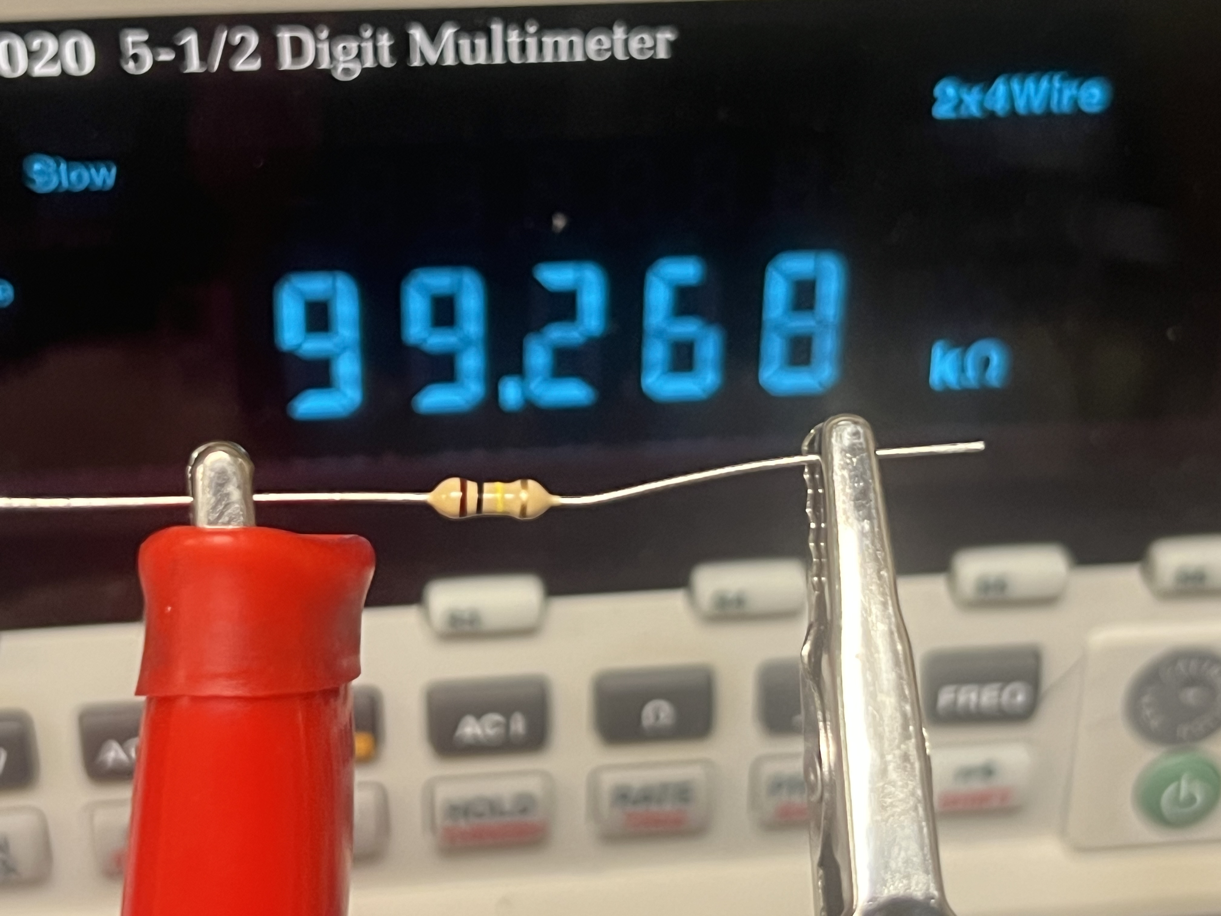
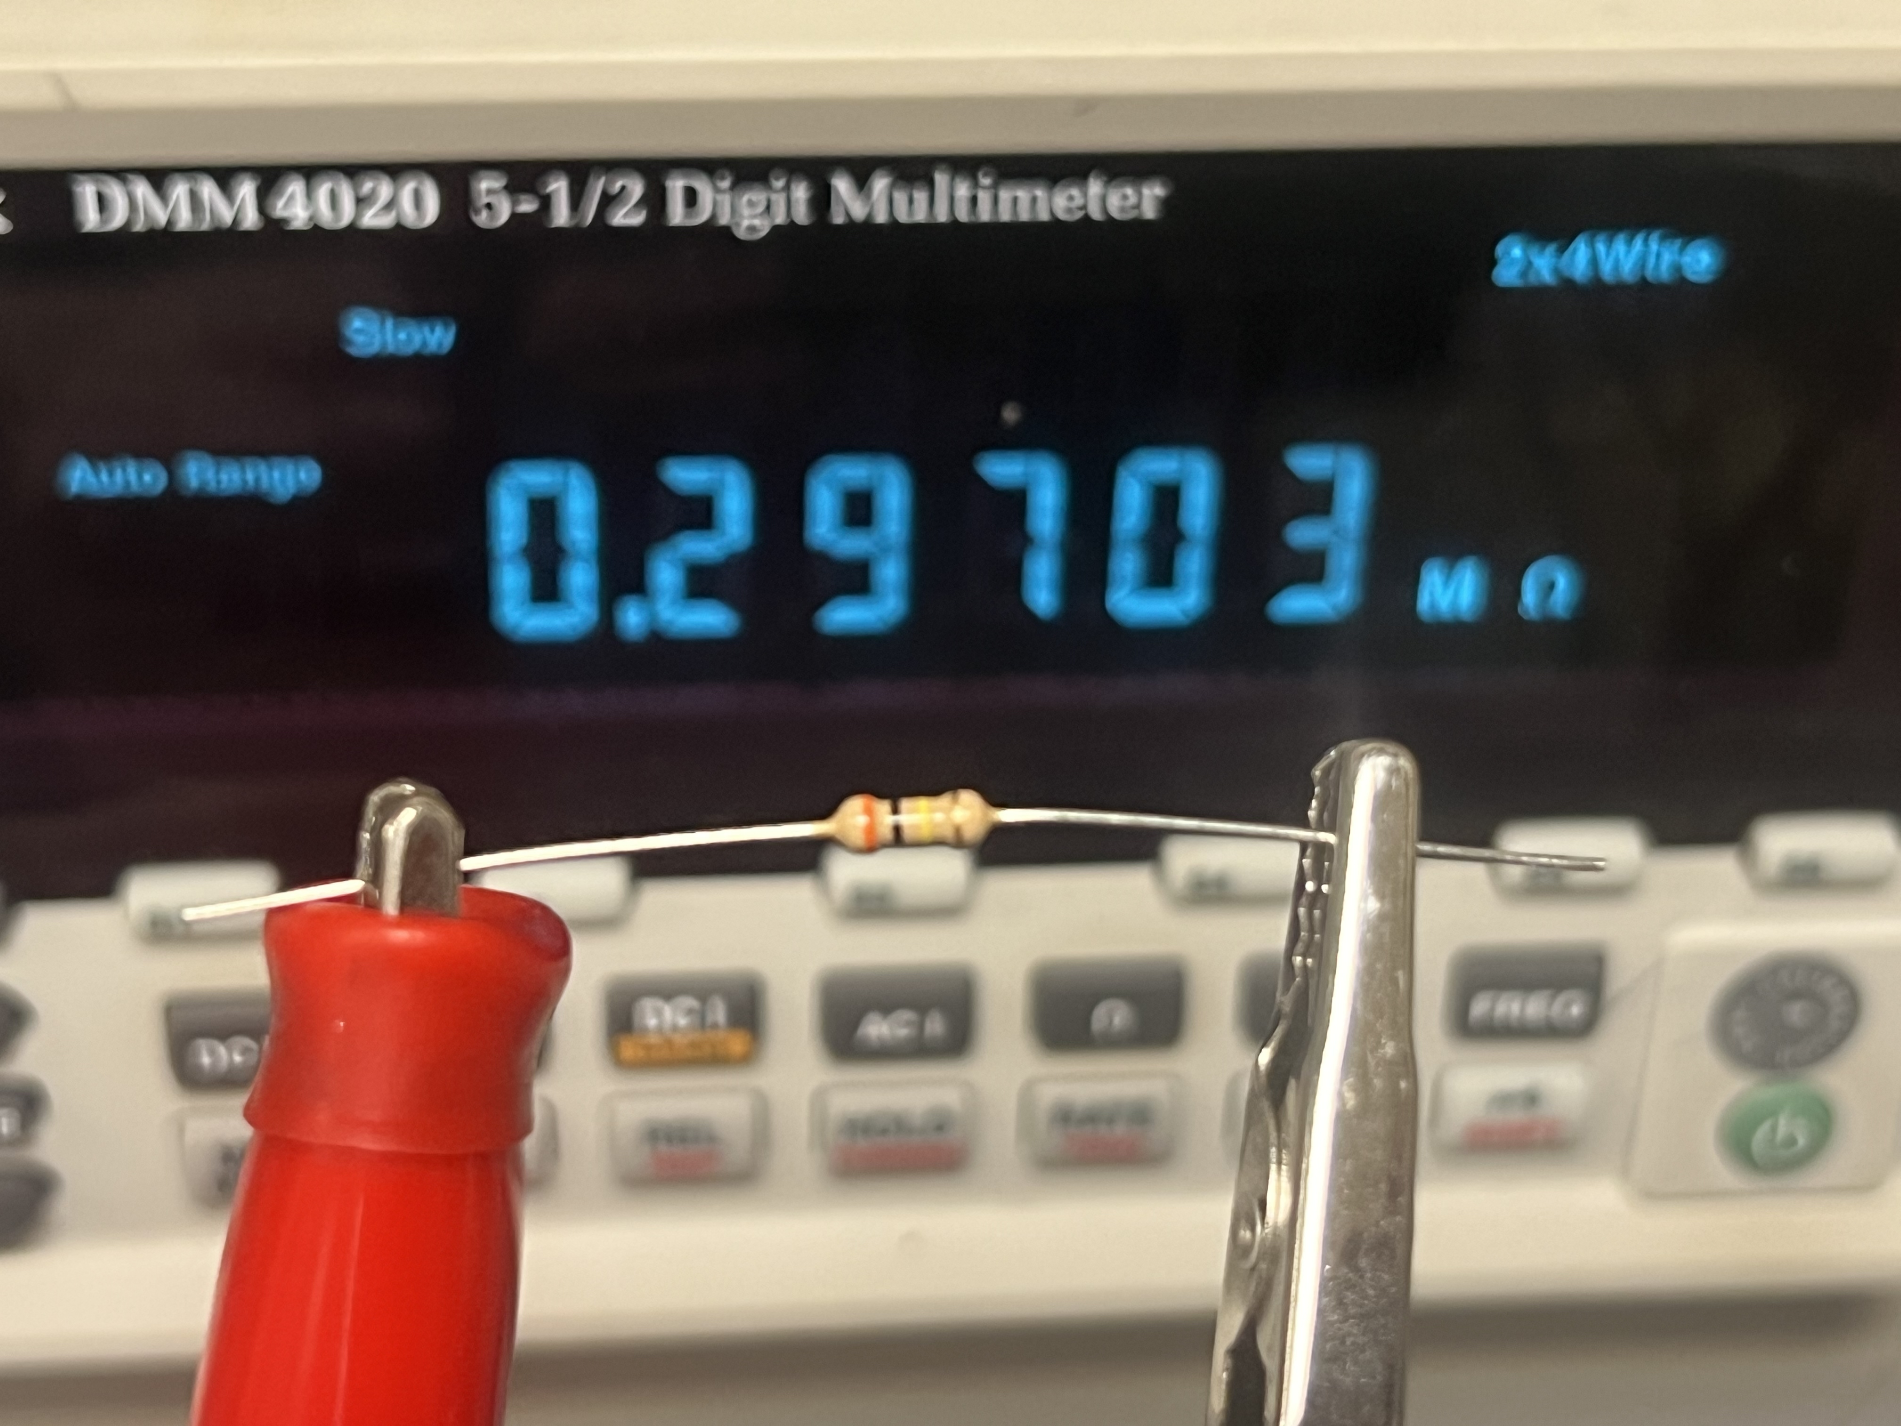
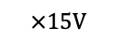
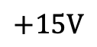
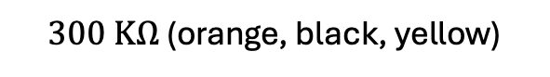
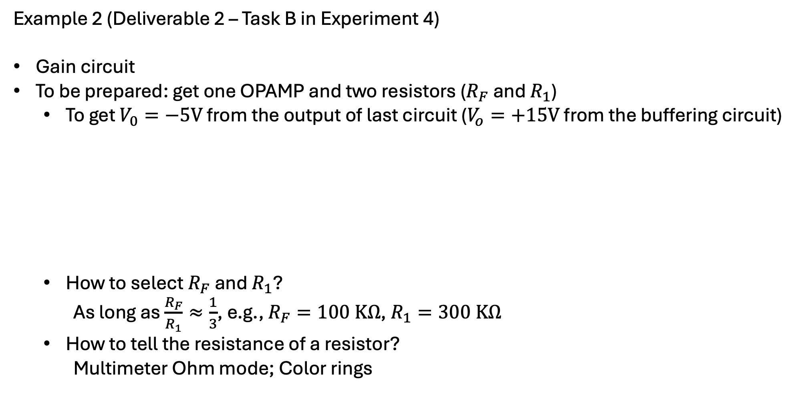
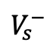
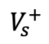
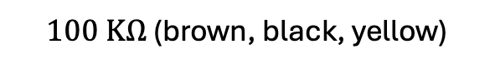
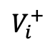
Example 2 (Deliverable 2 – Task B in Experiment 4)
Gain circuit
To be prepared: get one OPAMP and two resistors ($R_{F}$ and $R_{1}$)
To get $V_{0}=−5V$ from the output of last circuit ($V_{o}=+15V$ from the buffering circuit)
How to select $R_{F}$ and $R_{1}$?
As long as $\frac{R_{F}}{R_{1}}≈\frac{1}{3}$, e.g., $R_{F}=100 KΩ$, $R_{1}=300 KΩ$
How to tell the resistance of a resistor?
Multimeter Ohm mode; Color rings
$$V_{s}^{−}$$
$$+15V$$
$$×15V$$
$$V_{i}^{+}$$
$$V_{s}^{+}$$
$100 KΩ$ (brown, black, yellow)
$300 KΩ$ (orange, black, yellow)

Slide 6
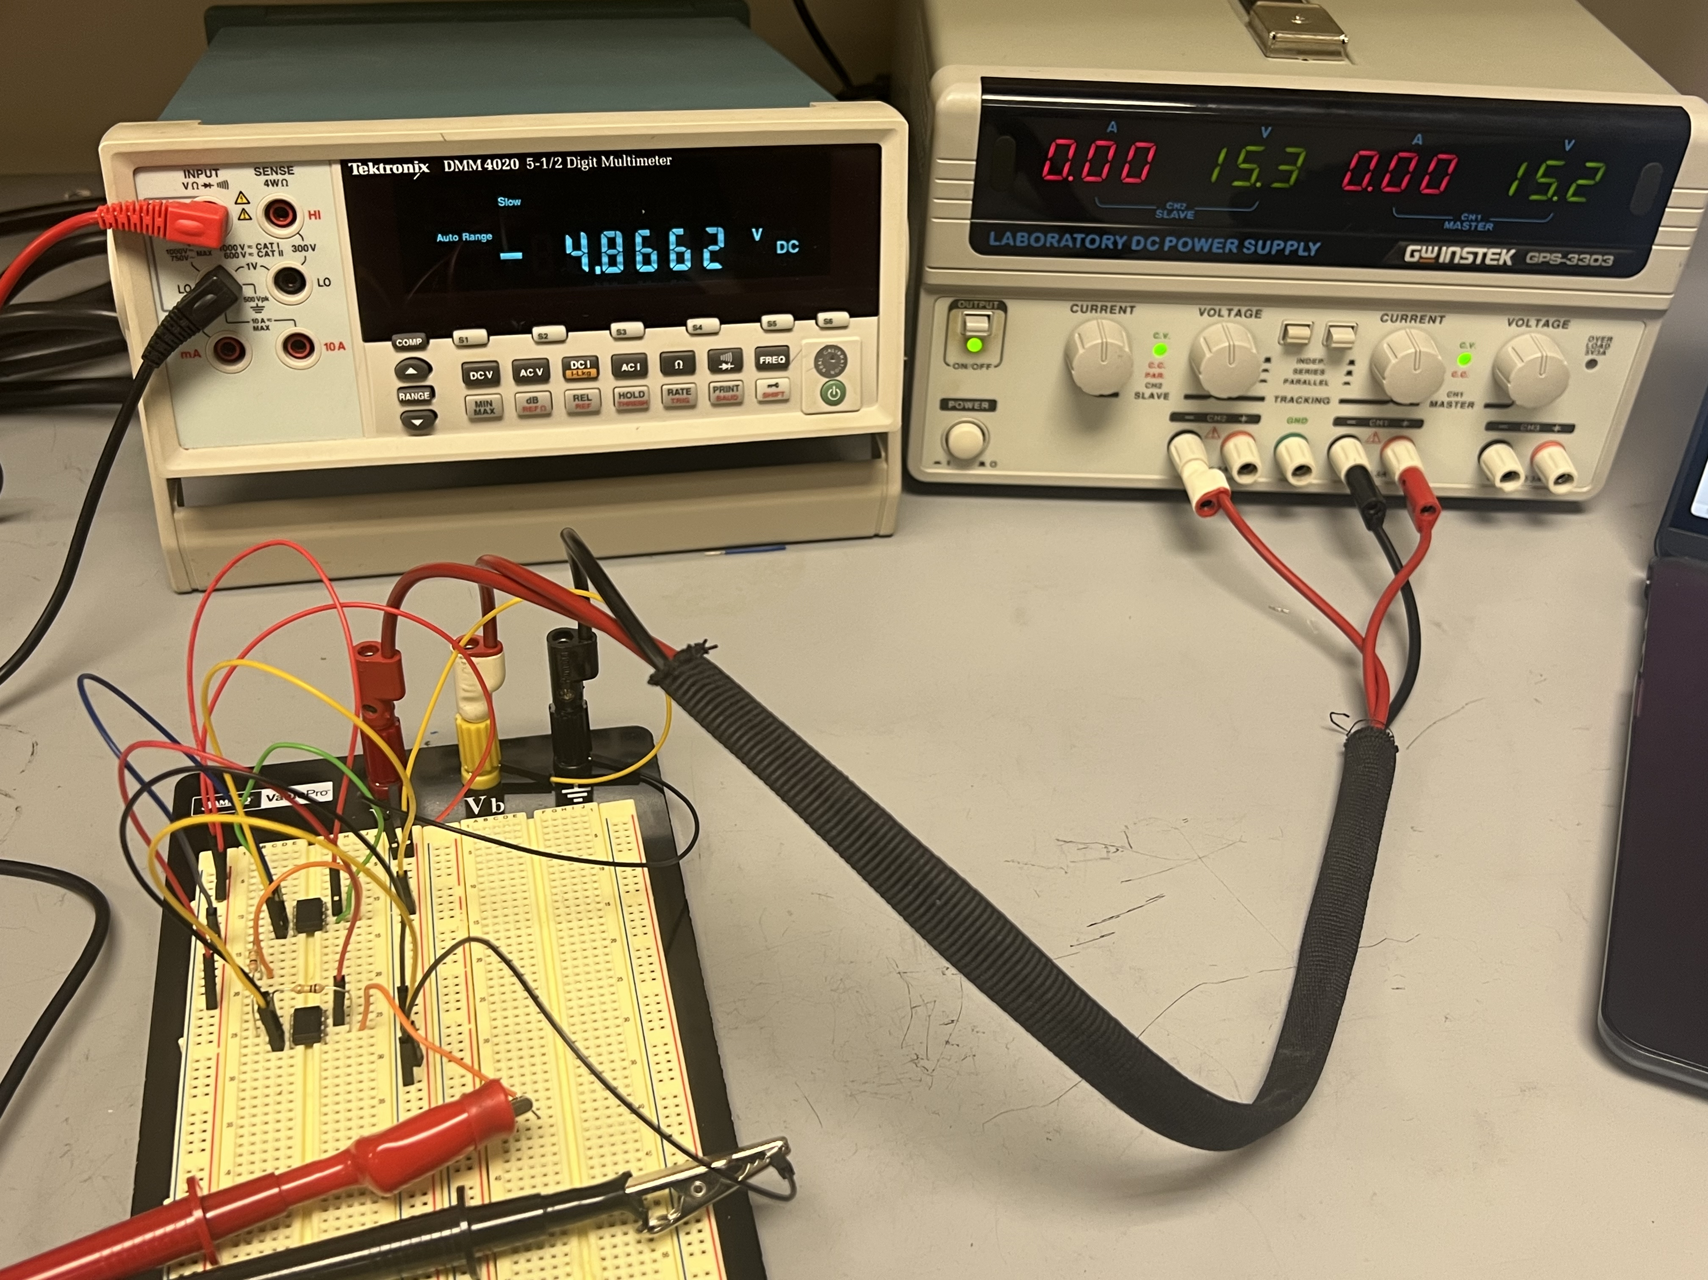
Example 2 – Cont’d
Expect Result: multimeter red input ($V_{o}=−5V$) – multimeter black input ($0V$) = $−5V$

Slide 7
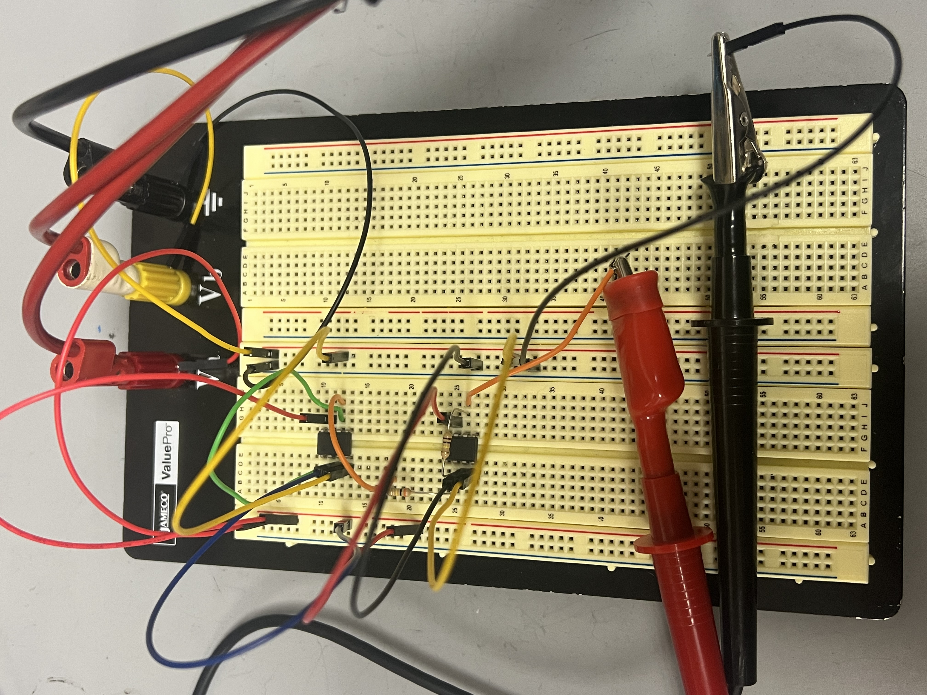
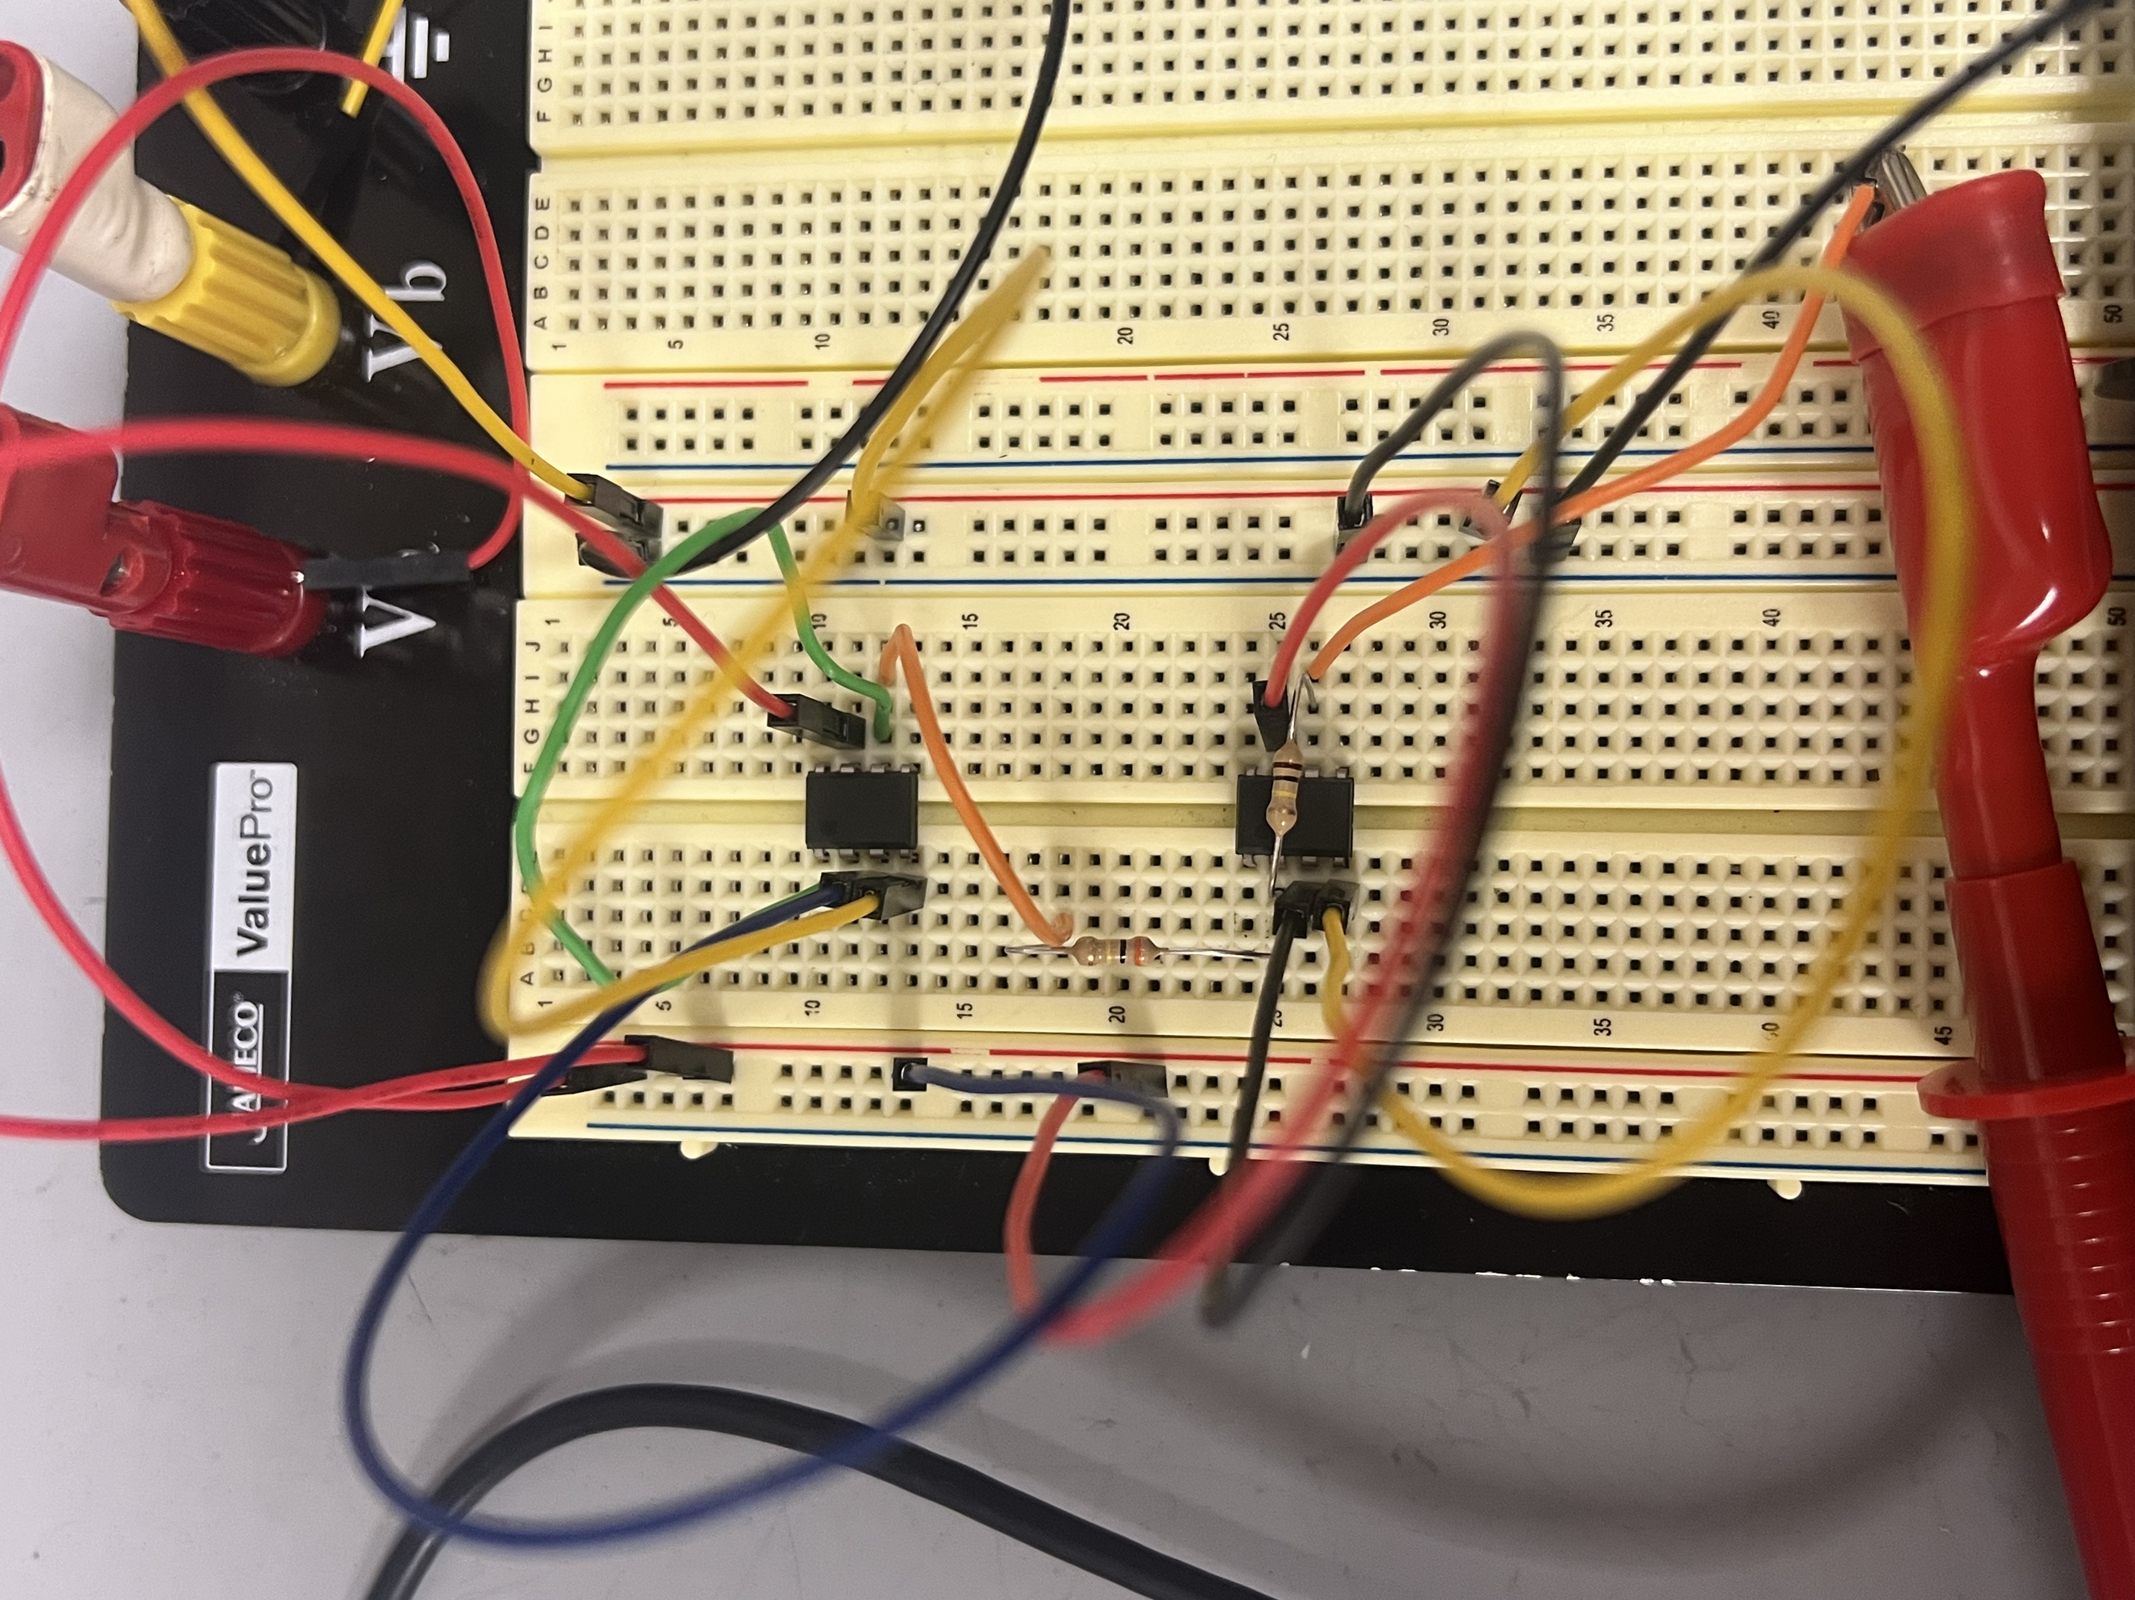
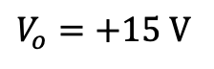
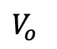
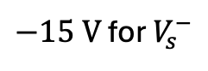




Example 2 – Cont’d
$$V_{o}=+15 V$$
$$R_{1}=300 kΩ$$
$$R_{F}=100 kΩ$$
$+15 V$for $V_{s}^{+}$
$0 V$for $V_{i}^{+}$
$−15 V$ for $V_{s}^{−}$
$V_{o}$

Slide 8



Deliverable 3 – Task C in Experiment 4
Summation of the outputs from circuit A and B
Deliverables Summary:
Tasks A, B, C, D, E in Experiment 4
Task F is not required
Deliverable 4 – Task D in Experiment 4
Invert the output from circuit B
With the gain circuit, but with gain $\frac{R_{F}}{R_{1}}=1$
Deliverable 5 – Task E in Experiment 4
Subtraction between the outputs from circuit A and D (A-D)

